Slide 1
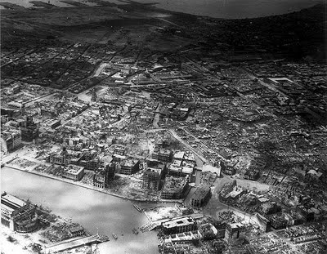
Japanese Occupation
Margs Baluyut
Gino Belgira
Seo Hyun Annie Lee
Raymond Cruz

Slide 2
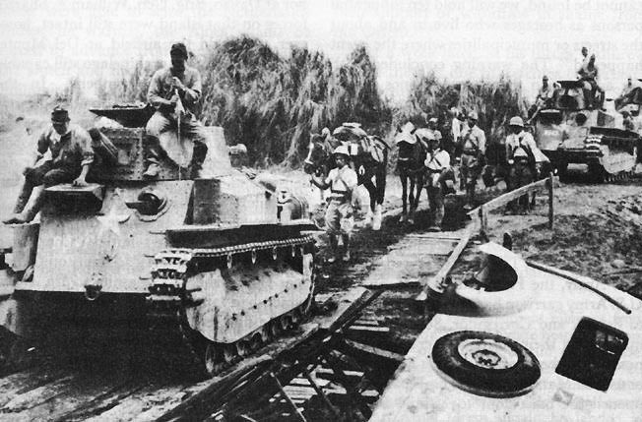
Withdrawal and Resistance: The Political Significance of Food, Agriculture, and How People Lived During the Japanese Occupation in the Philippines
(Benedict J. Tria Kerkvliet)

Slide 3
Political – Economic Background
Context of the Philippines up to 1941:
Absorbed increasingly into capitalist, modern world system
Provided raw and semi-processed materials to the “core”
1930’s, estimated 15-20% of country’s households depended upon the colony’s export-import economy for their livelihood
Exports were agriculture-based

Slide 4
Political – Economic Background
1941: 40% of the country’s cultivated land was devoted to its leading exports
Bicol, Davao = Abaca
Negros Province (Visayas), Pampanga and Tarlac (central Luzon) = sugarcane
Southern Luzon, parts of Mindanao = coconut
Northern Luzon and Ilocos area = tobacco
(These crops provided 60% of PH exports;
sugar alone comprised 30%)
Central Luzon = country’s “rice basket”
Produced 40% of the nation’s total in mid 1930’s)
Though per capita productivity was gradually increasing, PH still imported 4% of this as staple

Slide 5
Political – Economic Background
Agricultural output were turned into semi-processed material such as
Abaca fibers = cordage
Coconuts = cooking oil
Tobacco = cigarettes
Slight increases in demand for these raw materials during World War but nothing significant

Slide 6
Political – Economic Background
Filipinos had to deal with an erratic economy
2 implications
Philippines was strongly influenced by the world economy
Remained largely agricultural
Retained avenues for livelihood not directly linked to national and international markets
Many Filipinos had experience in dealing with erratic economic conditions
These helped people endure the disruptions that came with the Japanese occupation

Slide 7
Economic Collapse Under the Japanese Regime
Japanese military regime intent:
Convert PH from heavy US dependency to self-sufficiency in several agricultural sectors
Export to Japan and other countries that are part of the “Greater East Asia Co-Prosperity Sphere”
Centerpiece of regime’s plan: convert within 5 years half the country’s sugar land (200,000 hectares) and “idle and secondary forests” into 450,000 hectares of cotton
Also build textile industry to supply the PH and other parts of Japan’s empire
Cotton project was a failure though

Slide 8
Economic Collapse Under the Japanese Regime
Tobacco, abaca, coconut and sugar production subsided drastically as far as national and “Co-Prosperity Sphere” markets were concerned
Little of these came to Manila’s factories, resulting in scarcity of products such as cigars, twine, rope, cooking oil, etc.
Sugar production was also erratic

Slide 9
Economic Collapse Under the Japanese Regime
Palay (rice), was also emphasized by regime’s plan
Plan to increase production by 30% between 1943 and 1947 through
Enlarging growing area
Plant fast-maturing varieties
No evidence that the plan worked
By mid or late 1943, PH rice supply was smaller than before the invasion and decreased further
Statistics show that rice per capita was 15% less than prior to Japanese invasion

Slide 10
Economic Collapse Under the Japanese Regime
By 1944, official prices for most consumer goods doubled and even tripled
Black market price increases were even more steep
1 kg of cooking oil went from 10 centavos to 10 pesos
Eggs would cost a few centavos each went to 4.6 pesos the year after
Cavan of rice (56kg) was 6-7pesos increased to PHP30 by late 1942, PHP70 by mid-1943, PHP250 by 1944, PHP3000-5000 by late 1944 and as high as PHP12,000 in early 1945

Slide 11
Economic Collapse Under the Japanese Regime
Wages remained low
Japanese rule ordered 10-20% reduction in wages for male workers and further reduction for female workers
August 1943, legal maximum wage for unskilled labor was 1.30pesos per day
Official wages rose to 3-4 pesos a day
Despite rice rations, many jobs remained unfilled

Slide 12
Economic Collapse Under the Japanese Regime
Explanations as to why new government’s plans went unimplemented and economic conditions deteriorated so rapidly:
Military government’s place for cotton and rice production assumed too much
# 1
They supposed that cotton varieties successfully grown elsewhere would do likewise in the PH
Rice project assumed that irrigation system was better than it was and there would be rapid construction of new dams and canals
Many Japanese officials were confident that Filipinos would welcome the changes and generally cooperate

Slide 13
Economic Collapse Under the Japanese Regime
Military government’s place for cotton and rice production assumed too much
#2
A few months after new regime settled in the PH, the was went bad for the Japanese
By early 1943, armed forces were on the defensive on all fronts
Shift from five-year plan priorities to military priorities
War related needs diminished regime’s ability to win over a hostile civilian population and install a legitimate government

Slide 14
Economic Collapse Under the Japanese Regime
War damages and the occupation itself caused destruction and disruption between 1942 and 1947
Thousands of hectares of crop land went untended
Irrigation systems and research stations were destroyed
Water buffalo (principal draft animal for palay cultivation) was reduced to about 40% in 1945
More than 2/3rds of country’s 41 sugar mills were heavily damaged or destroyed, including rice mills, granaries, coconut and abaca processing plants, warehouses and factories were beyond repair

Slide 15
Withdrawal and Resistance
Filipinos reaction to the invasion
2 types of areas:
Occupied – refers to areas in which Japanese regime concentrated its military forces and government offices
Autonomous – refers to areas in the countryside and its population clusters that were both economically and politically “autonomous”
This area was beyond the reach of the regime
Sources of livelihood and commerce were broadly not affected to the occupied areas
Guerrilla
Non-guerrilla

Slide 16
Withdrawal and Resistance
Patterns emerged:
#1
Both occupied and autonomous areas despised, hated and resisted the Japanese regime
View of the people: regime’s lack of credibility to win allegiance of the populace due to
Context of the war
Misery they caused
Cruel way of treating civilians

Slide 17
Withdrawal and Resistance
#1
Both occupied and autonomous areas despised, hated and resisted the Japanese regime
Obvious ways of resistance
Guerrilla organizations
Subtle ways of resistance
Humor
Joked that the Japanese were characterized as slant eyed and bowlegged, stumbling around with rows of stolen wrist watches hidden in their shirt sleeves and pant legs
“Greater East Asia Co-Prosperity Sphere” translated as Sama-samang Kasaganaan sa Lalong Malaking Silangang Asya à Sama-samang Pagnanakawan sa Lalong Malaking Silangang Asya (The Greater East Asia Robbery Sphere)

Slide 18
Withdrawal and Resistance
#1
Both occupied and autonomous areas despised, hated and resisted the Japanese regime
Indirect resistance
Footdragging and sabotage
Pretending to cooperate with government’s cotton program and instead deliberately making “mistakes”
Administrative delay and obstruction within the bureaucracy became habitual

Slide 19
Withdrawal and Resistance
#2
Populations in both occupied and autonomous areas tended to withdraw from the formal to the informal sectors of the economy
Only small minority in the formal sectors could afford food and other necessities
Money became virtually worthless
Barter became mode of payment
“Buy and Sell”
Practiced in Leyte, central Luzon, Manila and Panay
Some made fortunes by accumulating scrap iron, gravel and other materials then selling them at high prices to the Japanese army and Navy

Slide 20
Withdrawal and Resistance
#2
Populations in both occupied and autonomous areas tended to withdraw from the formal to the informal sectors of the economy
Small-scale manufacturing using locally available materials also spread
Revived indigenous production that urban factories and foreign imports had diminished
Coffee, chocolate and soft drinks were either non-existent or prohibitively priced, people in Cebu, Leyte and southern and central Luzon returned to making beverages from ginger, coconut and other plants
Soap production in Leyte villages were intense
Handicrafts became a big thing in lowland towns and barrios and mountain villages

Slide 21
Withdrawal and Resistance
#2
Access to food
Urban areas, such as Manila, gardening became common
Direct links were devised between urban and rural food producers
Shift from growing tobacco, sugarcane, cotton and abaca to à corn, rice, sweet potatoes, cassava and vegetables
Some people resorted to robbery, banditry and prostitution

Slide 22
Withdrawal and Resistance
#3
Movement – people tried to anticipate where their chances for survival would be greatest
General direction was urban to rural / Occupied to autonomous areas
Fluctuations in population
1942, Manila’s population reportedly dropped from 700,000 to 300,000 (Same in Iloilo and Leyte)
But in 1944, Manila’s population grew back to 1 million
One reason was due to Japanese military’s offensives launch in late 1943
People went to urban areas to avoid conflict
People gravitated to small towns and larger villages in order to avoid isolation and vulnerability to Japanese patrols, bandits and rival guerrilla groups

Slide 23
Withdrawal and Resistance
#4
The fact that a move from an urban to rural area also tended to be a move from an occupied to an autonomous area
Occupied areas suffered the brunt of Japanese policies and abuses, and later the most damage from American forces
Autonomous areas tended to be safe and there were more opportunities
1943, food shortages were becoming so serious
Food was more available in provinces

Slide 24
Withdrawal and Resistance
#4
Hukbalahap guerrilla organization
Evolved from peasant organizations
Enabled many tenant farmers to retain more of their palay production and deterred landlords living in occupied areas from entering Hukbalahap strongholds
Held enough legitimate authority to retain food and shun Japanese troops
1943-1945, Japanese leaders sent troops to push into regions of guerrilla organizations destroying time crops and food stores and creating shortage

Slide 25
Withdrawal and Resistance
#4
Starvation and malnutrition in parts of Panay, Leyte and everywhere else
Political conditions were generally better in autonomous areas
Communities established their own governing bodies

Slide 26
Conclusion
Japanese regime resulted in terrible economic conditions in the Philippines lasting until late 1940’s
Had no profound impact on Philippine political and economic structures, therefore does not qualify as a major period in the country’s history
This period is important however in
The way people view themselves (individually and collectively)
How they internalize the history of their regions and nation
Sense of accomplishment, pride and integrity
Nation-wide resistance

Slide 27
Conclusion
David Steinberg: Filipinos fought and resisted but the presence of an elite divided by charges and countercharges of collaboration and the rise to power of corrupt and self-seeking opportunists demeaned wartime sacrifices
Basically it was a period of unity and pulling through as a nation

Slide 28
Conclusion
Filipino people faced political and economic adversity in 2 ways
1st: They withdrew from those sectors of society and the economy that the Japanese were trying to control
Fashioning buy-and-sell networks, living off the land
2nd: They resisted change
Indirect action that avoided confrontation with the oppressors to direct assaults on soldiers and stores of supplies
Autonomous localities frequently became support areas for guerrilla organizations and self-reliant forms of livelihood deprived the regime of labor and resources

Slide 29
Conclusion
Willard Elsbree: argued that Japanese occupation was a major turning point for SEA countries as it contributed largely to nationalist movements
Japanese occupation made a large impact on Philippine nationalism
“For the first time in the country’s history, the people defeated a foreign invader”

Slide 30
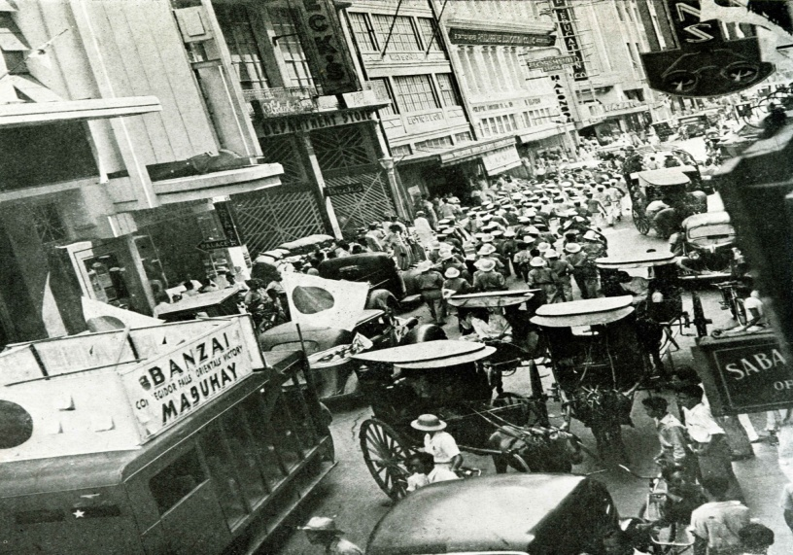
The Japanese Occupation of the Philippines
(Cortez, et al.)

Slide 31
Before the Occupation
Philippine Commonwealth remained under US authority
Philippine Commonwealth remained under US authority
Scheduled for independence by 1946
Japan as a second-largest trading partner of the Philippines

Slide 32
Before the Occupation
Japan as a menace, poised to take over after the US left
Japanese conquest of Manchuria – 1931
Sino-Japanese War - 1937
Large Japanese immigrant population
World War II broke out in Europe on 1 September 1939
Disruption of trade due to rerouting of merchant ships to the Atlantic
US economic measures against Japan reduced exports
Philippine revenues decreased

Slide 33
Before the Occupation
Civilian Emergency Administration (CEA) - April 1941
US and Commonwealth governments realized the need to prepare civilians for war
Lagged behind civil preparations in Malaya and the Netherlands East Indies due to peacetime inertia
Air raid drills, practice evacuations, and economic mobilization started in mid-1941
US Army Forces in the Far East (USAFFE)
Joint US-Philippine Army command
Gen. Douglas MacArthur recalled from retirement
Ready by March 1942

Slide 34
Outbreak of War and the Defense of the Philippines
World War II broke out in the Pacific on 8 December 1941
“This was a war to defend the country and its way of life”
Baguio and Davao bombed on the first day
Clark Field also bombed, destroying many fighters and bombers of MacArthur’s air force
10 December - bombing and destruction of the US naval base in Cavite, forcing the US Asiatic fleet to abandon Manila Bay as base of operations
Bombing of Manila caused panic, evacuation, looting
Initial Japanese landing in Batan Island, Aparri, Vigan, and Legaspi
Davao invaded on 20 December

Slide 35
Outbreak of War and the Defense of the Philippines
MacArthur’s defense plan
Hold the enemy at the beaches
Concentrated Filipino divisions on Lingayen Gulf, Zambales, Batangas, and Quezon province
22 December - Main Japanese landings in Lingayen Gulf, where Filipino lines were spread thin
Other landings in Atimonan and Mauban, in Quezon province
Failed

Slide 36
Outbreak of War and the Defense of the Philippines
War Plan Orange - 24 December 1941
Standard US Army defense plan for the Philippines
Withdrawal of all military forces in Luzon to Bataan and Corregidor
Seat of the Commonwealth also transferred from Manila to Corregidor
Declared Manila as an open city; all military forces and supplies removed
Spare Manila from further attack
Japan had no further reason to bomb the city, but nevertheless continued, causing many casualties and damage.

Slide 37
Outbreak of War and the Defense of the Philippines
Defense and Fall of Bataan and Corregidor
USAFFE resisted longer than the Japanese expected
Defenders hoped for reinforcements, but it never arrived
US Pacific Fleet was severely hit in Pearl Harbor
Japan controlled air and sea in the Philippines
MacArthur and Quezon evacuated to Australia
“I shall return”
Quezon evacuated to Washington DC
3 April 1942 - Japanese reinforcements and attack on Bataan
Defenders weak due to lack of food and medicine
9 April - Surrender of Bataan

Slide 38
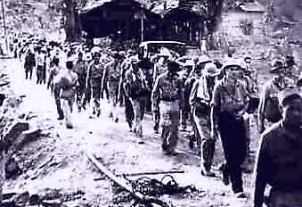
Outbreak of War and the Defense of the Philippines
Bataan Death March
Mariveles, Bataan to San Fernando, Pampanga
San Fernando to Capas, Tarlac (Camp O'Donnell) via train
Thousands dead
Fall of Corregidor
Gen. Jonathan Wainwright
Terms of surrender
The Japanese wanted the surrender of the entire Philippines, not just Corregidor
Gen. Wainwright ordered all commanders in the Philippines to surrender - 7 May 1942
“Proved to the whole world that the Filipinos could fight vigorously for the defense of their country, although hampered by lack of food, medicines, and armaments”

Slide 39
Under the Japanese
Manila taken by the Japanese on 2 January 1942
Martial law
Japanese Military Administration
Two governments
De facto government in the Philippines – JMA
Government-in-exile – Quezon
Quezon instructed national leaders to remain in Manila and cooperate with the Japanese, but only so they could alleviate the plight of the Filipinos
Jose Yulo, Jose P. Laurel, Claro M. Recto
Rather than Artemio Ricarte and Benigno Ramos

Slide 40
Under the Japanese
Quezon’s decision suited Japanese administrative policy
Leave civil affairs as much as possible to the existing administrative structure
The Japanese planned to use the existing bureaucracy to implement their aims and maintain stability
The JMA and the Japanese Fourteenth Army, under Lt. Gen. Masaharu Homma, would not advocate any radical social change

Slide 41
Under the Japanese
Philippine Executive Commission - 23 January 1942
Responsible not to the Filipino people, but to the Japanese
Jorge B. Vargas, Quezon’s prewar executive secretary, as chairman
Unnecessary prewar offices abolished or combined
The JMA and JFA still held final authority; all actions had to be approved
Recommended appointments for various government positions
Limited legislative function
All major government offices were assigned Japanese advisers

Slide 42
Under the Japanese
Restructuring for centralization of administration
Offices and provinces were reduced
Salaries lowered
All prewar political parties disbanded
Kapisanan sa Paglilingkod sa Bagong Pilipinas (Kalibapi)
District and neighborhood associations established
Rationing and distribution of food and other prime commodities
Served as check against guerrillas
Control public opinion (anti-Japanese sentiment)

Slide 43
Under the Japanese
Japanese Prime Minister Hideki Tojo
Dangled Philippine independence: promised it if Filipinos “understood the true meaning of Japanese Occupation, and cooperate as a member of the Greater East Asia Co-Prosperity Sphere”
Filipinos recover their true Asian spirit, worked towards economic self-sufficiency, and restored peace and order
Almost all Filipinos doubted the sincerity of this promise
Commission members decided to play along

Slide 44
The Second Philippine Republic
Inaugurated 14 October 1943
President Jose P. Laurel
Made to sign a pact of alliance with Japan, enabling Japanese forces to stay and Japanese nationals to exploit natural resources

Slide 45
The Second Philippine Republic
Attempts and plans
Exercise sovereignty by removing Japanese advisers and other personnel from Malacañang Palace
Restore peace and order
Restructure the shattered economy
Increase the supply of foodstuffs
Improve the distribution and sale of prime commodities
Improve social conditions and upgrade the moral consciousness of the people

Slide 46
The Second Philippine Republic
Many plans were stillborn: Time was short and conditions were hardly ideal
Presence of Japanese military forces
Irregular transportation and communications due to guerrilla resistance and bandits
Natural calamities
Lack of support from the people
In spite of “independence”, the Japanese remained in control
Manila: Laurel republic’s struggle to assert itself
Provinces: Japanese remained in control

Slide 47
Culture During the Occupation
The Japanese planned a major cultural reorientation
Reawaken Filipino indigenous culture as part of the Greater East Asia Co-Prosperity Sphere
Spread the Japanese language and culture
Filipinos to renounce their Western cultural influences

Slide 48
Culture During the Occupation
All forms of media were controlled
Newspapers and radio directly censored
Shortwave radios reconditioned so they could not receive broadcasts from Allied countries
Leaflets, posters, and pamphlets circulated
Sections about the US, the Commonwealth, and democracy removed from textbooks
Study of Japanese language became mandatory in schools, in some government offices it became a national language along with Tagalog
Radio Taiso instituted to instill Japanese discipline
The quest for the native Filipino culture was encouraged: encouraging people to go back to the barrio and rural life

Slide 49
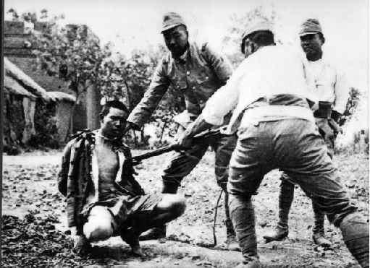
Economic Collapse
Main impression: economic hardship and Japanese brutality
The prewar Philippines was not economically self-sufficient: even rice
Under the Japanese Occupation, a severe lack of food and commodities was felt almost immediately
All import channels cut off by the war

Slide 50
Economic Collapse
War disrupted the farming cycle
Japanese military forces adopted a policy of local self-sustenance
Production reduced because farmers were reluctant to plant crops that would only be seized by Japanese or bandits
Plans to hike production failed due to climatic conditions and lack of cooperation by Filipinos

Slide 51
Economic Collapse
Irregular transportation and communication
All motor vehicles confiscated by the Japanese administration
Importation of oil and related products ceased; return to the horse-and-carretela stage
Only the Manila Railroad System available for the transport of people and commodities
Many bridges, roads, and communication lines damaged or destroyed
Transportation remained directly under the Japanese because of the incapability of local officials
Marine vessels destroyed or damaged; the Japanese attempted to build wooden sailing ships

Slide 52
Economic Collapse
Japanese five-year development plan to improve economic conditions
Ills of the prewar economic policy
Over-reliance on sugar as export product
Over-dependence on US market
Bolster food supply
Increase area devoted to planting food crops
New crop strains from Japan and Taiwan

Slide 53
Economic Collapse
Failure
Taiwan rice did not produce as much as expected
Farmers unfamiliar with new crop variety
Cotton did not yield as much as planned due to farmers’ reluctance to plant and harvest it
Many farmers sided with the underground resistance movement, denying their produce to the Japanese whenever possible
Typhoon in late 1943 destroyed much of the rice crop in central Luzon

Slide 54
Economic Collapse
People’s reluctance to accept Japanese military banknotes
“Mickey Mouse” money
Decreasing supply cased inflation - prices soared to impossible levels
Necessitated the printing of 500-Peso and 1000-Peso bills
People resorted to bartering
Black market

Slide 55
Economic Collapse
A different policy was implemented for Muslim Mindanao and Sulu
Separate Mindanao from the rest of the Philippines
Military necessity and lack of knowledgeable bureaucrats resulted in direct military rule
Never successfully occupied due to Muslim resistance and topography
Visayas and the mountain regions also unsuccessfully occupied

Slide 56
Filipino Reaction
Framework of the Philippines as an independent nation in the community of Greater East Asia, but military necessity came first
Negative impact
Japanese officers and soldiers resorted to corporal measures
The Kempeitai (military police) arrested and tortured suspected guerrilla members
Some military units commandeered food, vehicles, and houses
Rape of Nanking, China in 1937
Comfort women

Slide 57
Filipino Reaction
Japanese harshness and friendly relationship with the Americans drove Filipinos to reject and resist the Japanese
Active resistance manifested by guerrilla groups
Civilian support
Most groups were aligned with the US and received aid and support
MacArthur offered recognition to groups, to establish a system of order
Groups ordered to lie low and collect intelligence in order to prevent Japanese retaliation

Slide 58
Filipino Reaction
Groups
U.S. Army Forces in the Philippines, Northern Luzon (USAFIP NL), commanded by Maj. Russell W. Volckmann
Luzon Guerrilla Army Forces (LCAF) under Maj. Robert B. Lapham
Hukbo ng Bayan Laban sa Hapon, under Luis Taruc
East Central Luzon Guerrilla Area (ECLCA) under Lt. Col. Claude A. Thorpe
Free Philippines group
Anderson's Guerrillas (under Capt. Bernard L. Anderson)
Bulacan Military Area under Capt. Alejo Santos
Hunters ROTC Guerrillas under Eleuterio Adevoso
Marking's Fil-American Troops under Col. Marcos Agustin
Chinese Volunteer Guerrillas
Fil-American Cavite Guerrilla Forces under Col. Mariano N. Castañeda

Slide 59
Filipino Reaction
Groups
President Quezon's Own Guerrillas, under Vicente Umali
Various units in the Bicol area, under Lt. Wenceslao Vinzons and other leaders
Sixth Military District in Panay and environs, led by Col. Macario Peralta
Seventh Military District in Negros and adjacent islands, under Maj. Salvador Abcede
Cebu Area Command under James M. Cushing
Bohol Arca Command under Maj. lsmael P. lngeniero
Leyte Area Command under Col. Ruperto T. Kangleon
Palawan Special Battalion
Samar Area Command
Tenth Military District headquarters under Lt. Col. Wendell W. Fertig
Joint Muslim-Christian force of Salipada K. Pendacun

Slide 60
Filipino Reaction
Hukbalahap
Merger of prewar Socialist and Communist parties in central Luzon
Large peasant base and an agenda for postwar social reform
Did not follow “lie-low” order

Slide 61
Filipino Reaction
Government officials feigned collaboration but provided intelligence to guerrillas
Others degraded the Japanese, belittling and joking about them
Local food substitutes
Banana ketchup
Toasted coconut rind (Castanyog)
Survival
Cemeteries robbed
Racketeers
Electric and telephone wires stolen
Prostitution
Opportunists disguised as guerrillas
Worked with the Japanese

Slide 62
The Return of the Americans
Filipinos could follow the war from underground radios and newspapers
August 1944 - US planes bombed Japanese bases in the Philippines
September - Manila bombed
October - US troops landed in Leyte, MacArthur’s return
Battle of Leyte Gulf
Largest naval battle in world history
Kamikaze attacks first used
December - US troops landed in Mindoro
January 1945 - Landed in Lingayen Gulf
February - Entered Manila

Slide 63
The Return of the Americans
Laurel declared a state of war against the US
Kalipunang Bayan ng mga Pilipino (Makapili)
US forces aided by guerrillas
Manila and other key cities destroyed during Japanese defense
100,000+ civilian casualties due to Japanese massacres or fighting
Countless historical and cultural treasures destroyed

Slide 64
Return of the Americans
15 August 1945 - Surrender of Japan, end of World War II
Japanese resistance continued until the surrender of Lt. Gen. Tomoyuki Yamashita
The Commonwealth government was restored
President Quezon’s death due to tuberculosis in August 1944
Osmeña took over

Slide 65
After the War
The Philippines was ravaged
Industries destroyed
Economy derailed
Government restored but with no offices
Over a million lives lost
Relief and rehabilitation carried out by the US Army, the Philippine government and the United Nations Rehabilitation and Relief Administration
Government had no funds
The US pledged to repay the Philippines for every carabao lost

Slide 66
After the War
Independence granted in 1946
Php1.24B US rehabilitation act
Losses estimated at Php16B
US Senate required that the Americans be given the same privileges as the Filipinos in exploiting natural resources
Economic blackmail
Free trade extended until 1973

Slide 67
After the War
Prosecution of Japanese collaborators
Prosecutors vs. those who prefer to let the issue pass, or those who saw most collaborators as softening the blow of Japanese rule
People’s Court created
President Manuel Roxas granted amnesty to collaborators in 1948
War reparation claims from Japan

Slide 68
After the War
Other problems
Rackets and confusion in war damage claims and backpay benefits for veterans
Disappointment with the US’ treatment of Filipino veteran claims
Discrimination in veterans’ benefits
Rebuilding the shattered economy
Social instability (peasant rebellion)
Loose firearms

Slide 69
After the War
Failure of the government to resolve issues led to the awakening of nationalist sentiments in later years
Even today, the wounds, losses, and confusion which resulted from World War II and the Japanese Occupation are still very much present

Slide 70
After the War
Japanese Occupation as testing ground of the Philippines as a nation
Many chose to actively resist (guerrillas)
Others cooperated with the Japanese to soften the impact of the Japanese Occupation
“The Philippines was virtually united in opposing, directly or indirectly, the new colonizer. In another sense, the Japanese Occupation showed Filipinos that they could survive hardships and difficulties on their own. The economic trials brought to the fore the ingenuity of the Filipino, and enabled him to survive.”

